Slide 1
Social partners going digital
Stavroula Demetriades
Senior Research Manager
Digital trade unionism – How to be the strong organisation in the digital jungle
Czech-Moravian Confederation of Trade Unions, 29 March 2023

Slide 2
Eurofound 2021-2024
Mission
Vision
Strategic objective
To provide knowledge to support the development of better informed social, employment and work-related policies
Being Europe’s leading knowledge source for better life and work
To provide scientifically sound, unbiased, timely and policy relevant knowledge that contributes to better informed polices to improve living and working conditions and strengthen cohesion in a changing Europe

Slide 3

Fun(damental) facts
100 staff members
EU agency
Budget of € 22.75 million (2021)
Established in 1975
Based in Dublin
Brussels Liaison Office

Slide 4

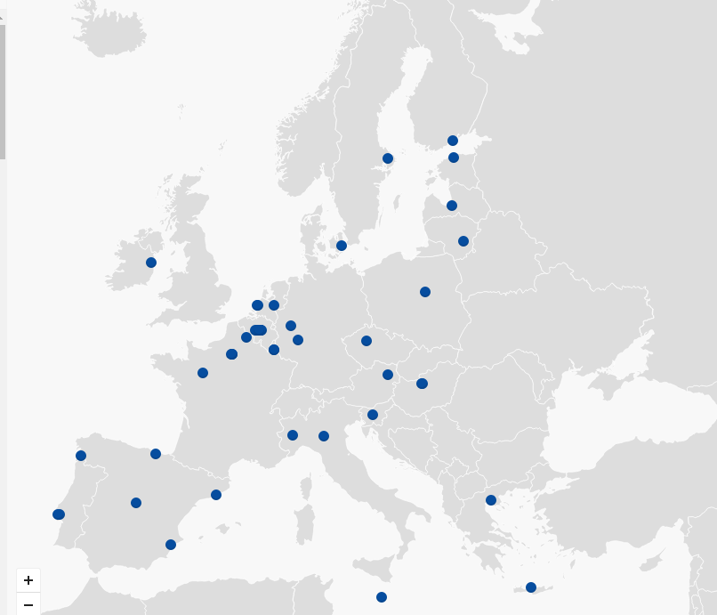
Agencies of the European Union
46 Agencies across Europe
Distinct from the EU Institutions –
separate legal entities
Help make Europe more competitive
and a better place to live and work
Support EU Institutions –
contribute to implementation of EU policies

Slide 5
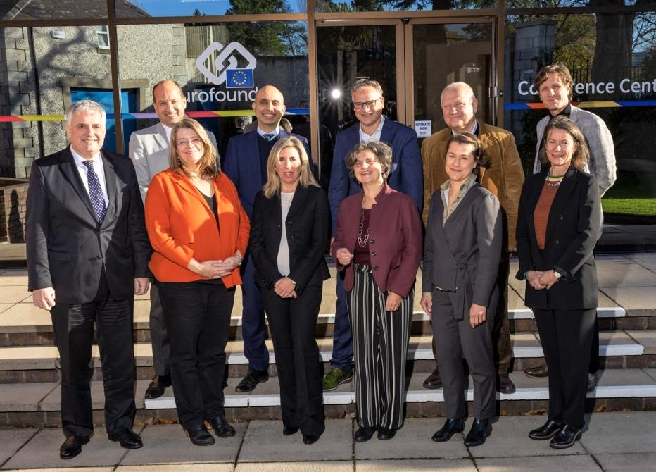
Governance

Slide 6

What is tripartite representation?
National
Governments
Employers
Trade Unions

Slide 7
2021-2024: Research activities
Working conditions and sustainable work
Industrial relations and social dialogue
Employment and labour markets
Living conditions and quality of life
Anticipating and managing the impact of change
Promoting social cohesion and convergence
Notes:
Working conditions and sustainable work
providing comparative data and analysis that can be used to improve job quality and promote sustainability of work over the life course
Industrial relations and social dialogue
functioning as a centre of expertise for monitoring and analysing developments in industrial relations and social dialogue, promoting dialogue between management and labour
Employment and labour markets
providing knowledge to identify changes in the labour market, and inform employment policies to improve its functioning and inclusiveness
Living conditions and quality of life
mapping and analysing key elements for the improvement of living conditions of people, including information on their perception of quality of life and society
Anticipating and managing the impact of change
providing evidence on structural changes, driven largely by digitalisation and climate change, but also by the COVID-19 crisis that can be of use in ensuring just transitions which promote employment, good working conditions, social protection and workers’ rights, while also improving labour productivity, competitiveness and prosperity
Promoting social cohesion and convergence
contributing to the policy debate on fairness and informing policies aimed at improving social cohesion and promoting convergence toward better living and working standards in the EU

Slide 8
The Eurofound-Cedefop European Company Survey 2019
Survey of (HR) managers and employee representatives (ER) in European establishments
Most senior person in charge of HR in the establishment (MM)
Official employee representative (works council/trade union)
Topics explored: Skill strategies, motivation and trust, work organisation, HRM, employee involvement, digitalisation, product market strategies, degree of competition, outcomes (productivity, financial conditions), social dialogue.

Slide 9

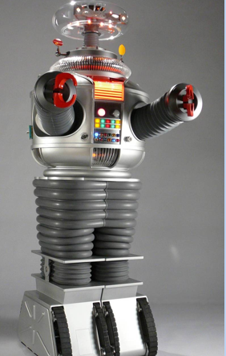
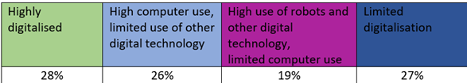



Digitalisation and work practices- evidence from ECS2019
44% companies >60% employees
8%
54% of managers
28%
Process improv:46%
Employee performance: 27%
Both: 51%
Photos source: link, link2, link3, link4

Slide 10
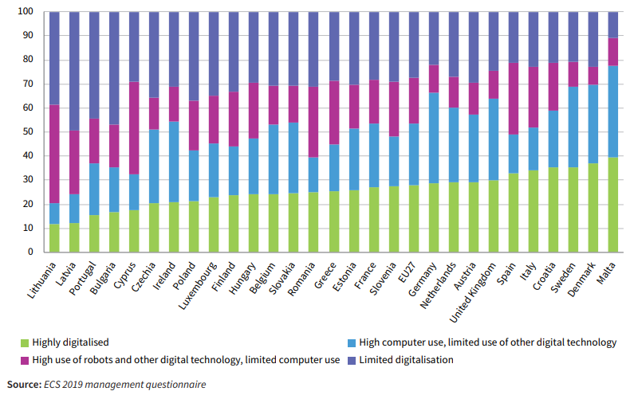
Digitalisation by country

Slide 11
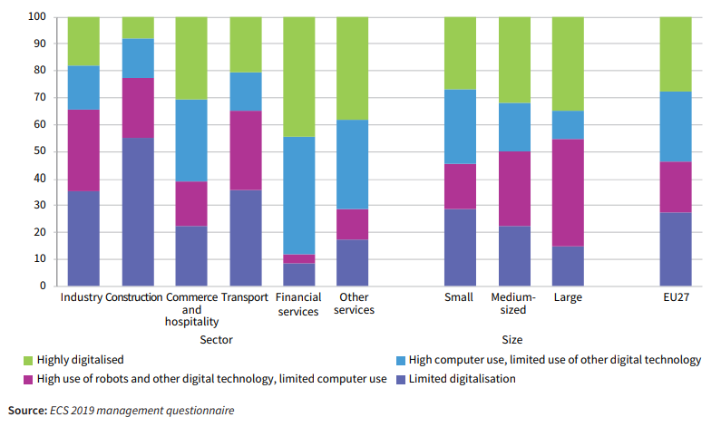
Digitalisation by sector and establishment size

Slide 12
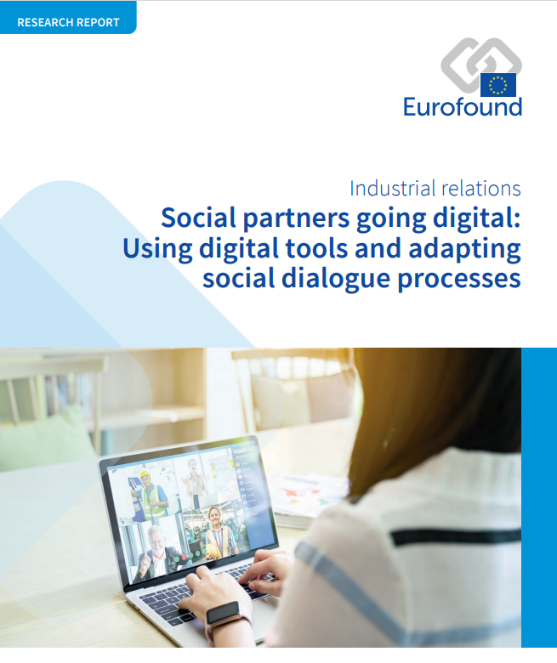
Eurofound research report 2021

Slide 13

The use of nascent technologies by the social partners
Training
Recruiting members
Optimising admin processes
Capturing members’ views
Information sharing
Guidance, advice, counselling
Electronic voting and online protesting
Virtual meetings
Trade unions
Employers
Notes:
Capturing members’ views: DK, Danish Association of Social workers introduced Game (started as a physical game and then they moved it online) =tool for prioritizing needs and demands before negotiations on CA on both local and national level.

Slide 14
Some examples..
AT tu in health & social care; MT, SI
HR: online protests
ES UGT: support to platform workers
Guidance, advice, counselling
Electronic voting and online protesting
DGB (D):Hackathon how to reach out to members, & support them
Optimising admin processes
Information sharing
AT trade unions: ÖGB webpage which includes all collective agreements; AK webpage with labour law issues

Slide 15
What challenges do social partners face?
Challenges | Trade unions | Employers
Lack of digital skills | AT, BE, BG, CY, EE, FIN, FR, GR, HU, MT, NL, NO, PL, PT, RO, SK, SI, SP, SE, UK | AT, BE, BG, CY, EE, FR, GR, HU, NO, PT, RO, SK, SI, SE, UK
Digital infrastructure/technology | AT, HU, IE, LV, LT, LU, NL, PL, PT, SK, SI, SP, UK CZ (ČMKOS and ASO ČR > member trade unions): how to use the full potential of websites and social networks | AT, BG, EE, FR, GR, HU, LU, RO, SK, SI, SE
Data protection issues | BG, FIN, HU, IE, MT, PL, RO, SI, SE | BG, FIN, FR, GR, HU, IE, LU, RO, SK, SI
Notes:
TU: ČMKOS and ASO ČR: web and social media used for disseminating opinions, supporting points of view, press releases [TU1= Czech-Moravian Confederation of Trade Unions (Českomoravská konfederace odborových svazů, ČMKOS); TU2= Association of Autonomous Trade Unions of the Czech Republic (Asociace samostatných odborů, ASO ČR)
EO: SP ČR, KZPS ČR: Web and social media for disseminating opinions, supporting points of view, press releases [EO1= Confederation of Industry of the Czech Republic (Svaz průmyslu a dopravy České republiky, SP ČR) EO2= Confederation of Employers' and Entrepreneurs' Associations of the Czech Republic (Konfederace zaměstnavatelských a podnikatelských svazů České republiky, KZPS ČR)

Slide 16
Challenges and remedies
ASO ČR: Online collective bargaining not as effective; digital skills
KZPS ČR : Some sectoral organisations use technological solutions more intensively;
SP ČR, KZPS ČR: digital skills
Challenges | Remedies
Lack of digital skills | Training, online courses
Digital infrastructure/technology | Recruitment of qualified IT staff; seeking funding
Data protection issues | Data protection officers; data protection and cybersecurity guides, security protocols, awareness raising, training
Notes:
DK tu DJOF: Risk of losing the ability to differentiate between members and their different needs. Members need personalised, tailored service so if you digitalise all then you may alienate members. Digitalisation works well with general enquiries, remove administrative burdgen.

Slide 17


Digital forms of consultation and collective bargaining: what do social partners think?
Efficient meetings, no travel required | Negotiations are based on trust, need face to face meetings
Attendance of top officers, CEOs of large companies | Mobilising employees’ reps
EWC, EU level meetings | Technical skills & infrastructure
Towards hybrid social dialogue processes?
Notes:
Covid time online meeting and negotiations: more rounds than usual to reach agreement. TU found it difficult to mobilise ER for collective negotiatins to gain support and acceptance of outcomes of negotiations during lockdown.. Some SP said that digital negotiations could be useful where there was previously good relationship and an understanding between the parties.

Slide 18
Social partners integrating provisions on digitalisation aspects in their collective agreements (Examples)
Company level
Sectoral level
Cross sector
AT, BE, FIN, FR, EE, ES, IT, LU, NO,
Small number of CEC among them
CZ: peak level
DE, DK, ES FIN, FR, IT, NL,RO
Notes:
Not a mapping of CA (that would have been valuable as well as the SP importance in shaping legislation).
Most CA at sector and mainly company level. But overall, only half of MS (no mapping) BUT small # CEC
Cross-sector CA: Commitment to engage in SD
Sector level: set up structures to monitor job reclassifications, transformation in occupations and work tasks so that they can address them in the future CA. Also, they are used for sharing good practices on digitalisation, to avoid malpractice.
Company level: Most of CA. aim to accelerate the adoption of digital technologies (i.e. referring to type of technologies unlike sectoral CA) and regulate employment and working conditions.
CZ: At the peak level, the social partners have been intensively involved in digitalisation and its impacts on the economy and the labour market since around 2015, National Industry 4.0 Initiative (Národní iniciativa Průmysl 4.0) but not CA. CZ TU: mainly interested in impacts of digitalisation on the LM whereas EOs in technical issues and financing of introduction of digital tools.

Slide 19
Sector Agreements (examples)
Country | Agreement
Denmark | Local Government Denmark Agreement (2021)
 | Medical staff (2018)
 | Transport (2020-2023)
Finland | Technology sector (2020)
Germany | Public sector ongoing (2021)
Italy | Electricity (2019)
 | Gas & water (2019)
 | Banking (2015-2019)
Netherlands | Insurance (2019-2021)
Romania | Banking
Spain | Medical transport Public admin and property registry (2020)
Monitoring transformation of jobs, skills,
work tasks, job classifications, setting up
observatories, cooperating with training providers
Need for exchange practices!

Slide 20




Sectoral collective agreements
Banking sector collective agreement:
Joint sectoral observatory
Digitalisation impacts work organisation,
New tasks, new occupations,
job reclassification
Transport sector transformation:
Self-driving cars
Online tools for assessing competencies
available to workers of the sector

Slide 21

Company agreements
Banking
Post
Telecommunications
Energy
Port
Automotive
Media
Food

Slide 22

Main topics addressed in agreements (any level)
• Training and development
• Work organisation models, ‘humane’ work design
• Working conditions, employment, and industrial relations
• Alleviating risks of job losses
• Telework
• Platform work

Slide 23
Company agreements
Eurogate port operator (2019,Germany) Automation & jobs
Dismissals for operational reasons avoided until 2025
Assessment of staff skills and training
Employees holding posts no longer needed due to digitalisation will be reassigned
New working time arrangements
Commission on automation
Post S.p.a. (2019,Italy) Reorganisation, automation
Large investment (€150 million) in physical and technological infrastructure & automation
Reorganisation > reassignment, redeployment, shift to part time work
Stabilisation of fixed-term contracts
Recruitment of new staff

Slide 24
Company agreements
Gasag, energy provider (Germany)
Internal online crowdsourcing open to all and transparent.
Change in work organisation, gamification as an employee motivator
Standards in working conditions, H&S, learning
Data protection, employee monitoring not allowed
Risk assessment
H&M and Ver.Di collective agreement (9/11/2022, source: mindRH)
Creating a digitisation committee (with workers and management reps)
Work jointly on future concepts
Digital technology in line with the employee interests

Slide 25
National debates and the role of social dialogue in a digital era
Digitalisation
Skills & jobs
Work organisation models, human centric approach
New forms of work & remote work
Techno-stress
AI & robots
Digitalisation transforms jobs, occupations, sectors and will impact on social actors and social partnership. Social partners to jointly exploit options
Digitalisation topics on the future social dialogue
Data protection cyber-security

Slide 26

How can social dialogue introduce innovative and forward looking dimensions?
Setting up guidelines, principles regarding use of digitalization (improve work environment and operations) (FI)
Monitoring mechanisms
Agreements that anticipate & respond to changes (e.g. training, support, co-shaping job profiles)
Technology and ethical aspects

Slide 27
Lessons learned
Social partners and use of digital media: similar types of technologies but varied use across countries. Challenges for organisations and opportunities
Are practices of digital forms of consultation and collective bargaining here to stay? Some, yes! Moving towards hybrid forms? Possibly, yes
Provisions on digitalisation aspects in collective agreements: Still plenty of room for expanding collective regulation across MS!
Czechia social partners deal with this mainly at peak level, few collective agreements
Key topics already in some collective agreements are likely to gain fresh momentum
Reflection on the future social partnership and emerging issues: intensification of debate, actions in preparation

Slide 28
EU level
“The social dimension must always be designed along the technical dimension of an AI system to make sure that the system is not designed to the detriment of quality employment..
….To guarantee a successful implementation of technological change, social partners at company level should work together on the introduction and shaping of new systems at the workplace, at an early stage.
Social dialogue is best placed to deal with all employment related aspects of technology, including inequality, skills, the nature of work, work organisation and
the prevention of discrimination.”
Ceemet (European Tech & Industry employers), IndustriAll (Joint conclusions 2023) Artificial intelligence in the MET (metal, engineering and technology) industries

Slide 29


The way forward
Speeding up the adoption of new digital technologies within social partner organisations and operations
Supporting capacity building activities on digitalisation
Intensifying efforts to jointly address social aspects of digitalisation and their impacts on work and employment

Slide 30
Děkuju!

