Slide 1
Digital transformation with unions in the UK
CMKOS Digital Trade Unionism project – 03/2023
Notes:
The TUC is the national federation for unions in England.
We have 48 unions, with around 5 million members. That’s about 23% of British workers.
So I’d like to talk to you a bit about three things
- unions and digitisation in the UK
- what we are trying to do to support our unions in the TUC
- and the ways in which the coronavirus pandemic has changed the digital environment for unions.

Slide 2
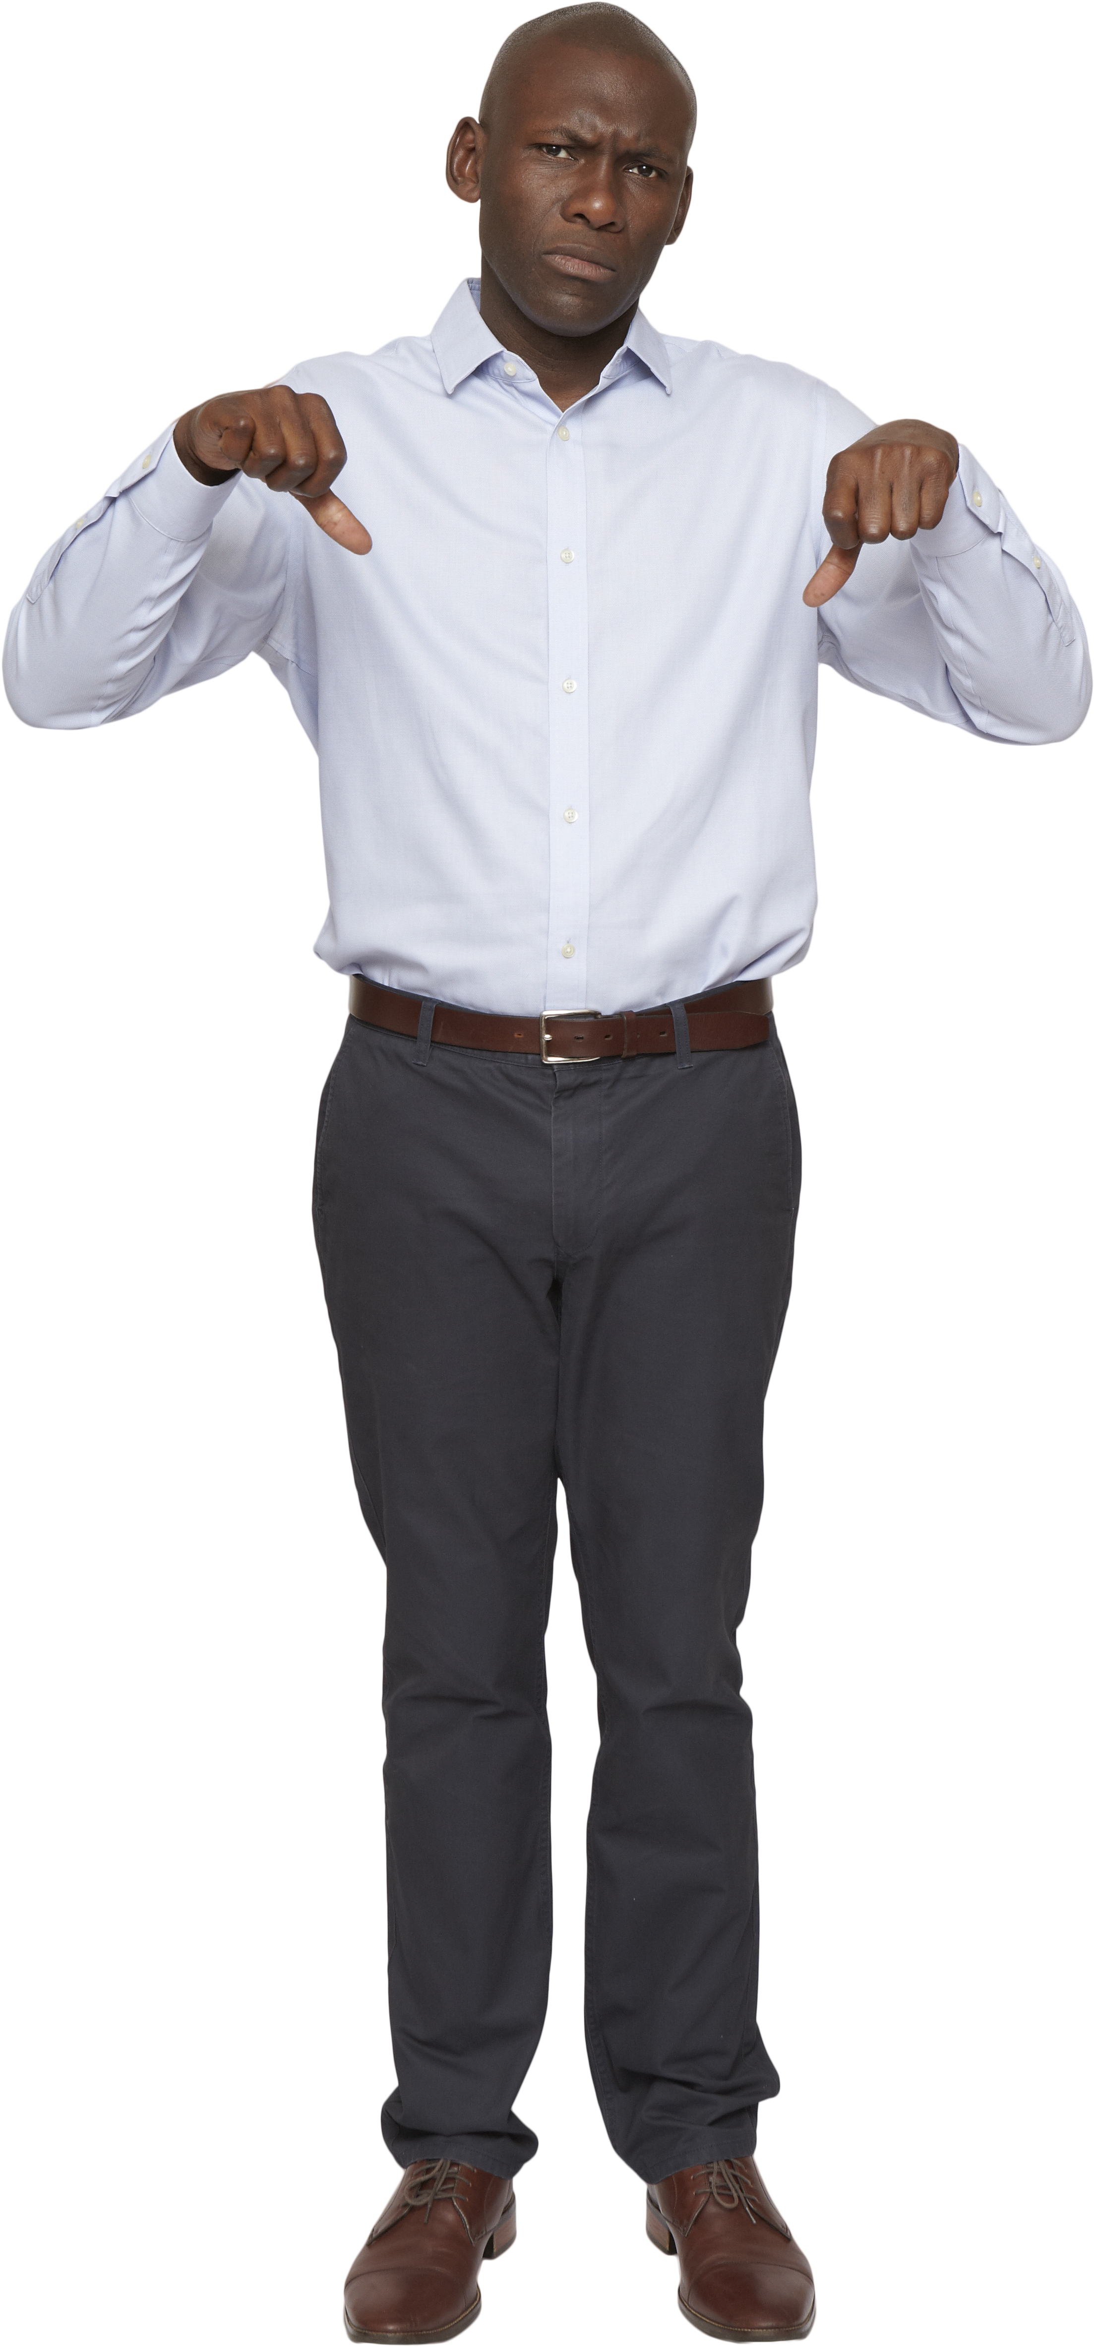
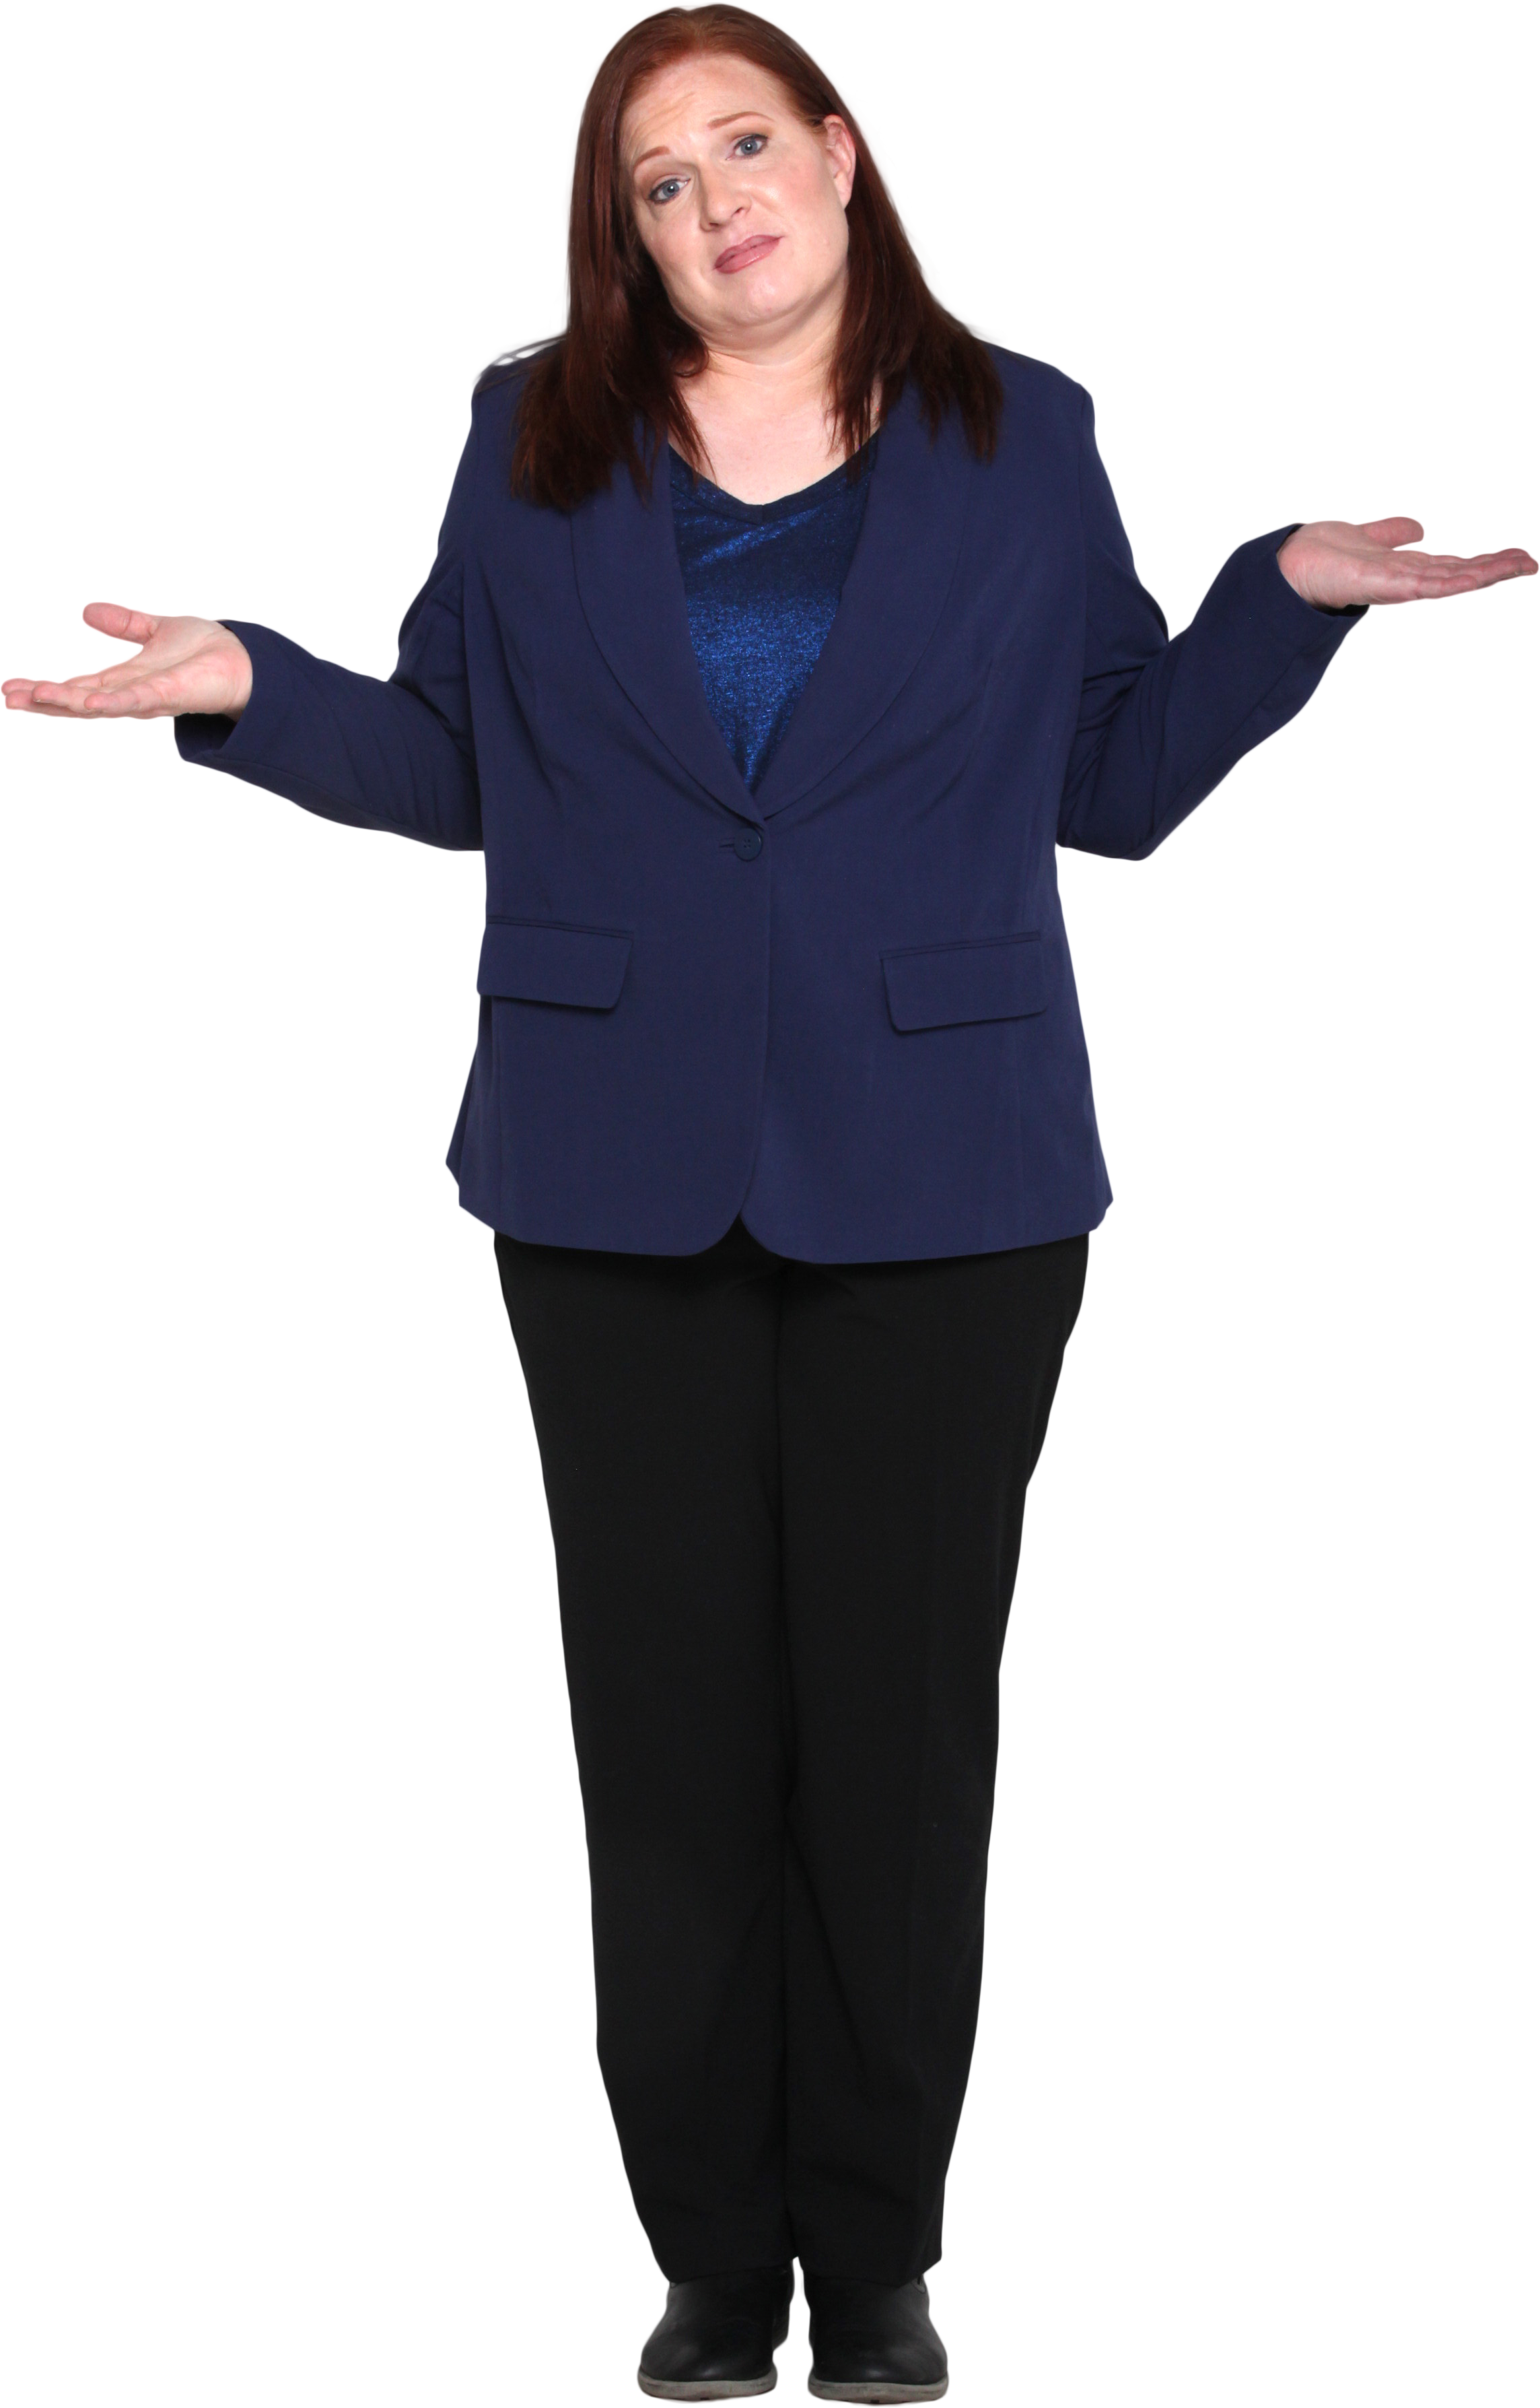

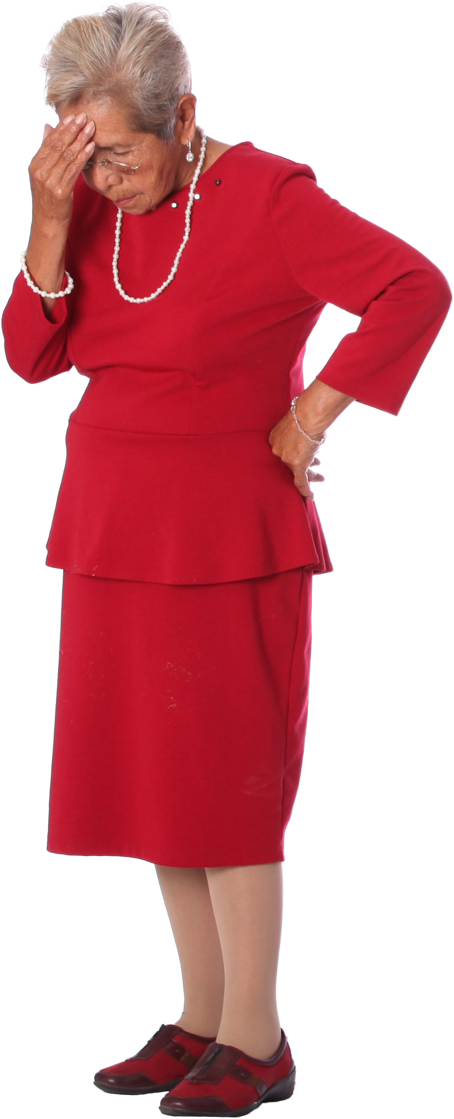

1
2
3
4
5
Notes:
1 My first question is about how important digital technologies were to you personally during the COVID lockdown?
2 Next question. How well do you think digital actually did what you needed it to do? Did it make things easy and positive or did it make the whole thing harder?
3 Let’s think now about the members of our unions. And how members were able to connect digitally with the union during the pandemic. If your members were going to vote, what score do you think they would give? How easy was it for them to switch to digital, and do everything digitally with your union during that period?
In the UK, when we ask these questions, we see that there is a gap between what people might want from everyday services they use online, and what unions are able to offer them right now.

Slide 3
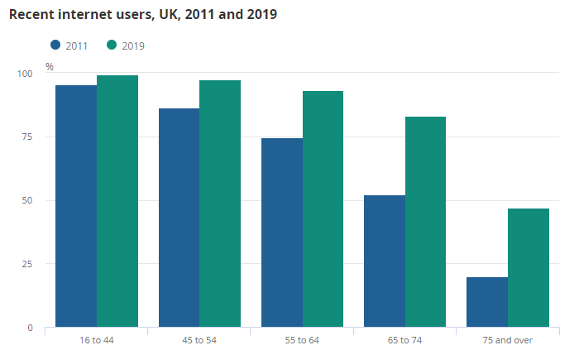
Notes:
So I want to start here with a quick explanation about what I mean by digital, and why I think it’s so important for unions.
First thing - it is very clear that digital is the mainstream choice.
Here is a chart of what proportion of British people of each age group used the internet regularly - in 2011 and 2019.
This data is old now - the numbers are even higher.
But it shows us that for working age people, nearly everyone is currently regularly using the internet.
And as unions are organisations of working age people, that should be important to us.

Slide 4
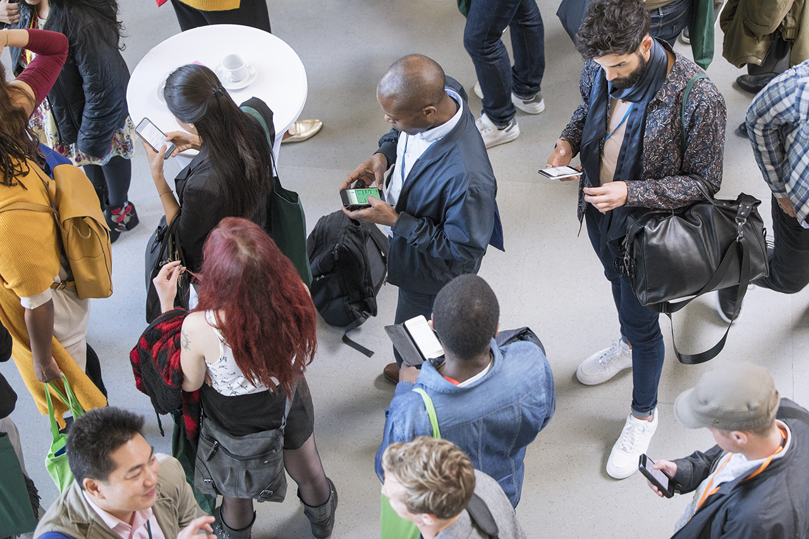
Notes:
Mobile has been one of the key factors driving this change.
Smartphones mean that nearly everyone is now online - whenever they need to be, and wherever they are.
That gives them a different and more natural relationship with digital than they had before.

Slide 5
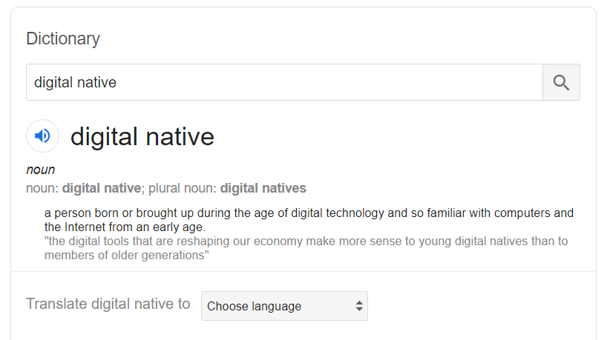
Notes:
We have a new generation of what we call “digital natives”.
The millennial generation - people who started their careers after the year 2000 - are now more than half the UK workforce.
That means their whole working lives have been during the internet age - they don’t know a different way of doing things.

Slide 6
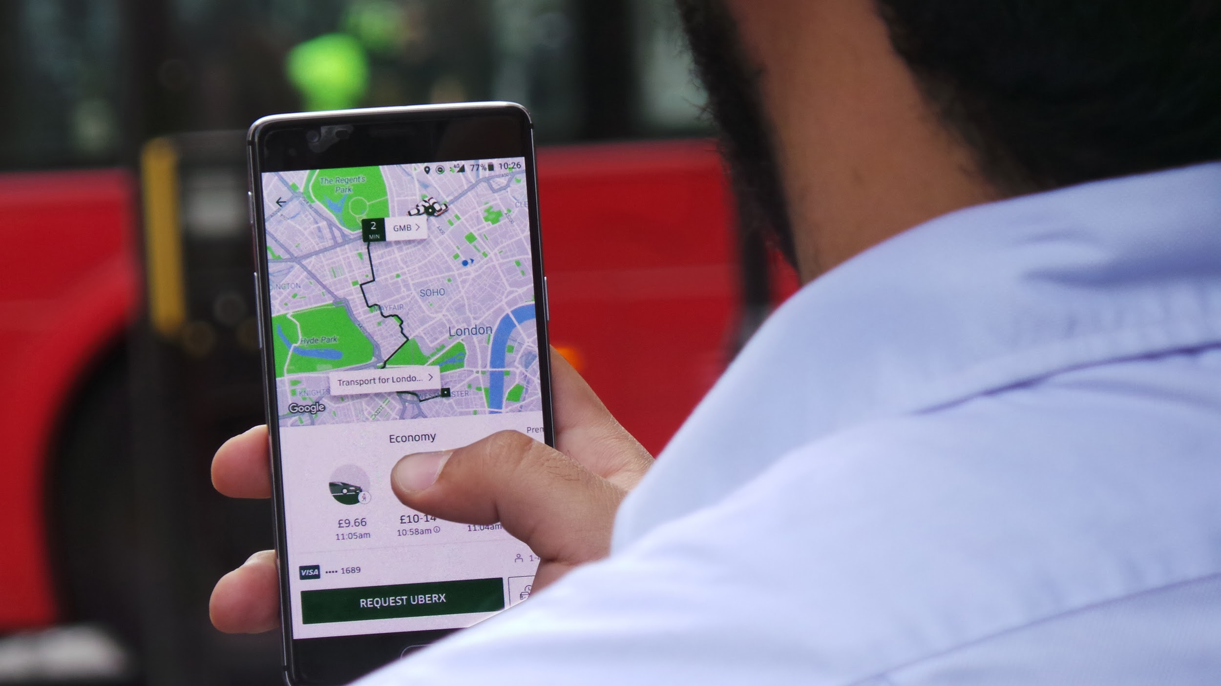
Notes:
When you combine that huge market with the ease of starting a digital-first business, this has led to an explosion in new digital services.
Uber are a great example here. They are a terrible company for their workers but in just a few years they went from zero to 3.5m users, just in London.

Slide 7
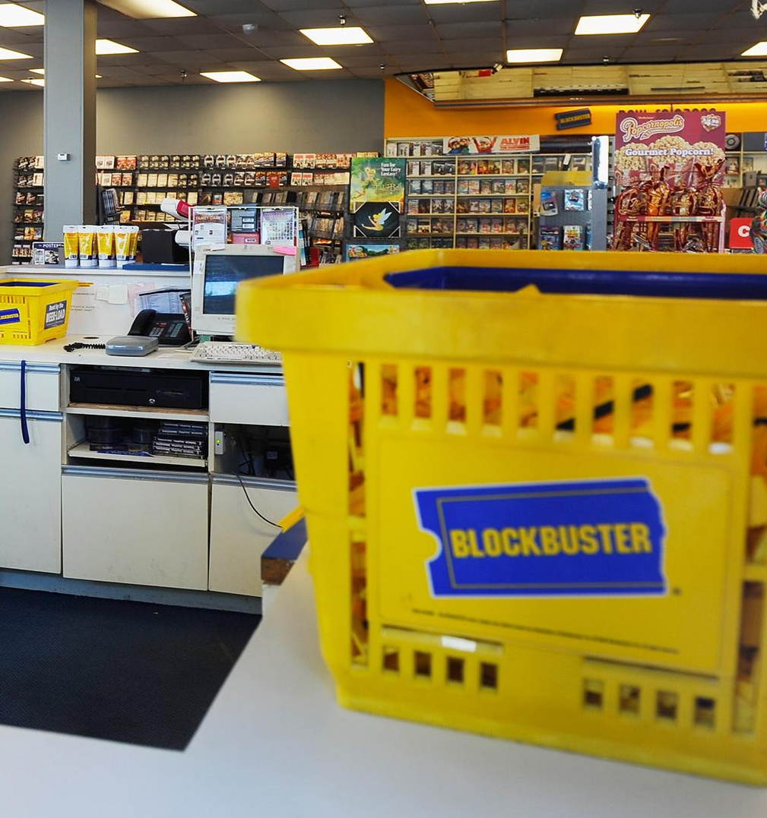

Notes:
And once people use those new digital services, it raises everyone’s expectations of how easily they can interact with companies, government and organisations like unions.
That is something that older companies and organisations can find it hard to keep up with.
So when we talk about digital and digitisation, we are talking about how existing organisations adapt to meet people’s new expectations.
Digital includes technology, but it isn’t just about technology.

Slide 8

Notes:
So what does that mean for unions?
Well, if unions were just starting today, our values would be the same, but our structures and ways of working might be very different.
The challenge for us is to take what has worked well in the past, but make it relevant in the new environment.

Slide 9

Notes:
But there is a problem. Unions are not as fast as employers or companies in how we digitise.
It’s difficult. There’s not a lot of shared digital infrastructure for unions. And not much IT experience at senior levels. So costs can be more than we’re used to.
And our rules and structures were designed long ago to be sustainable and democratic, not to respond quickly to a changing environment.

Slide 10


























Services
Platforms
Challengers
Campaigners
Notes:
But all that leaves us vulnerable to new competitors.
In the UK we’ve got lots of digital groups and companies that are starting to grow in areas that were traditional union strengths.
Some of them are good people who might be allies. Others are competitors who could damage and replace us.
We know unions are the best route to building sustainable worker power.
But if working people look at how we work, and think other options work in the way they want, then everyone loses.

Slide 11

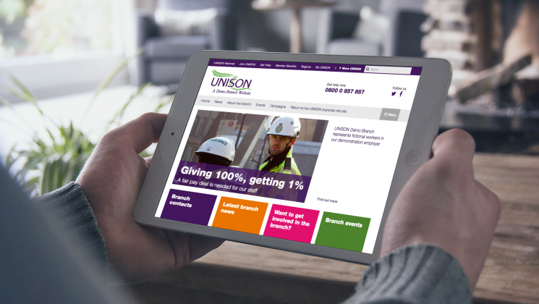
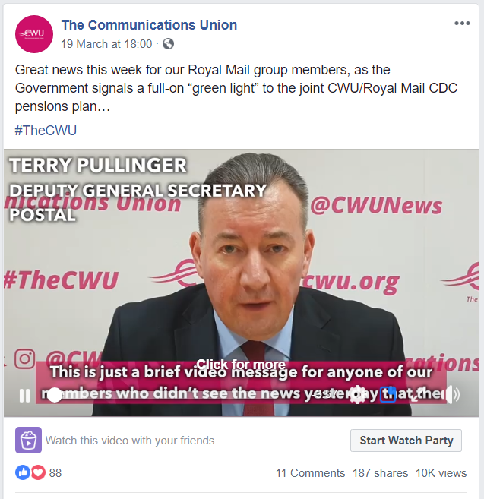

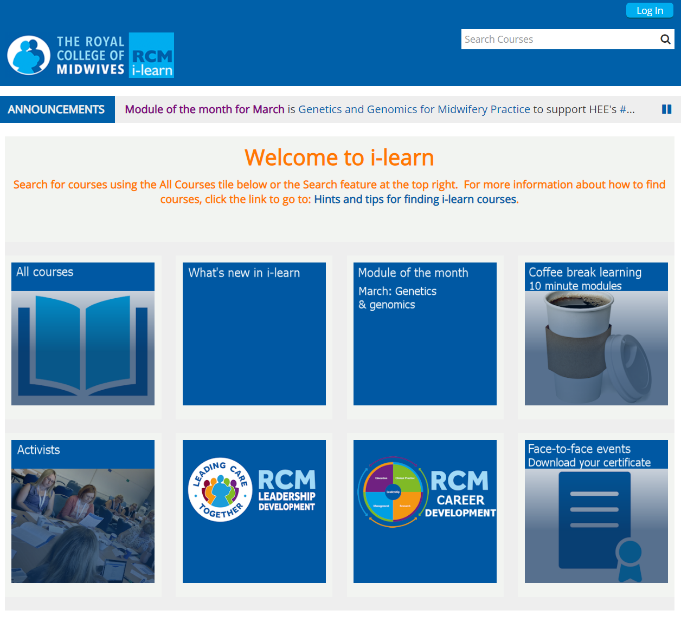
Notes:
It’s not that there is nothing good happening in our unions.
There is loads of very good digital work being done.
But the learning from it isn’t always being shared as well as it could be.
We aren’t getting the benefits of being a movement

Slide 12

Notes:
Which is why we started the TUC’s Digital Lab programme
We’ve been working for four years now.

Slide 13
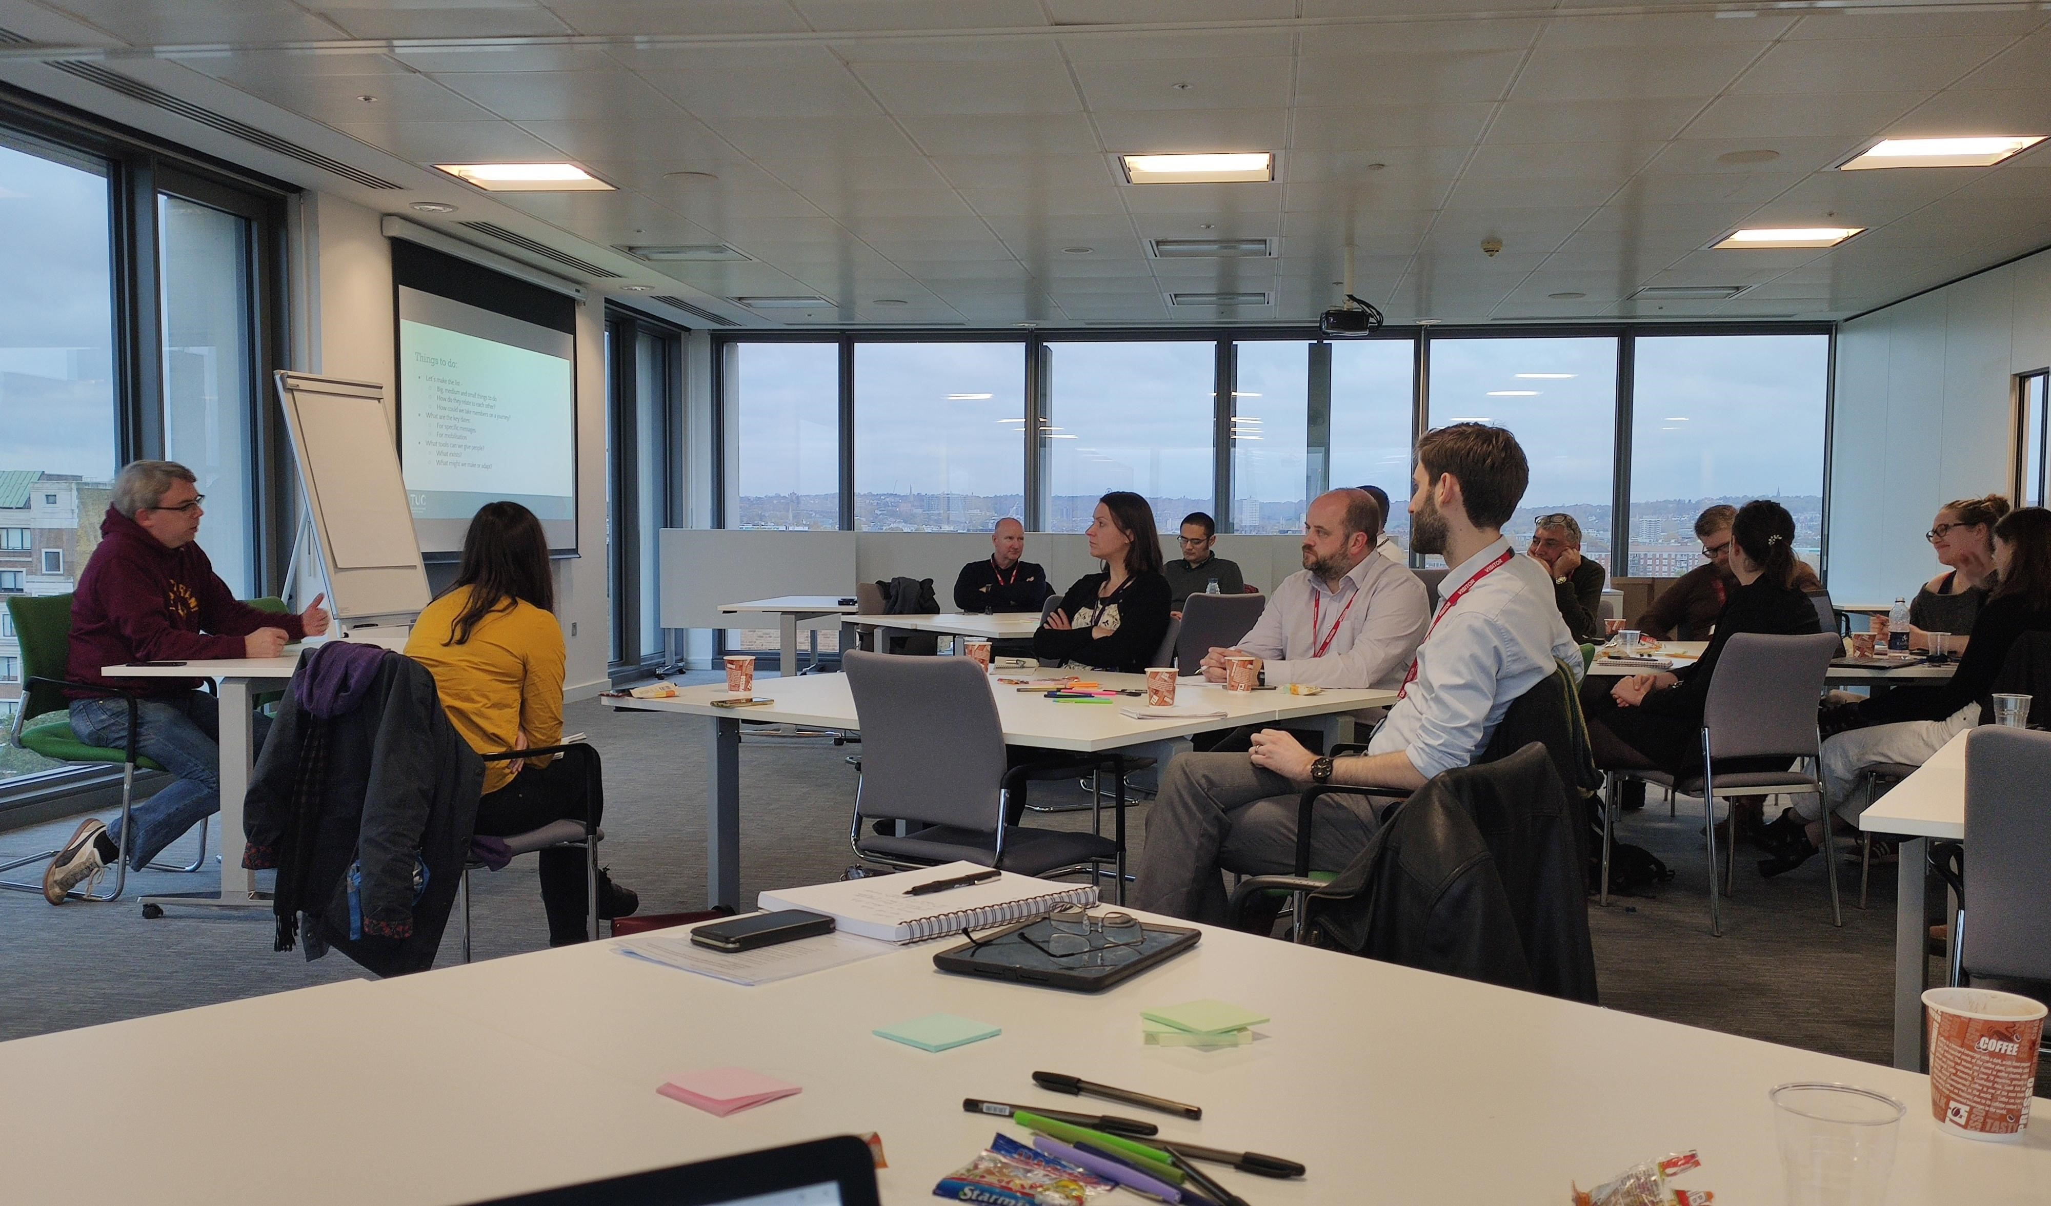
Notes:
We run events and workshops for our unions on different topics around digitising their operations.
We help them work out together what good practice might look like - and help share it between them

Slide 14
Notes:
We publish reports and tools to help unions understand how well they are doing.
This is our interactive digital assessment tool, that they can use to evaluate their own technical infrastructure and strategy.

Slide 15
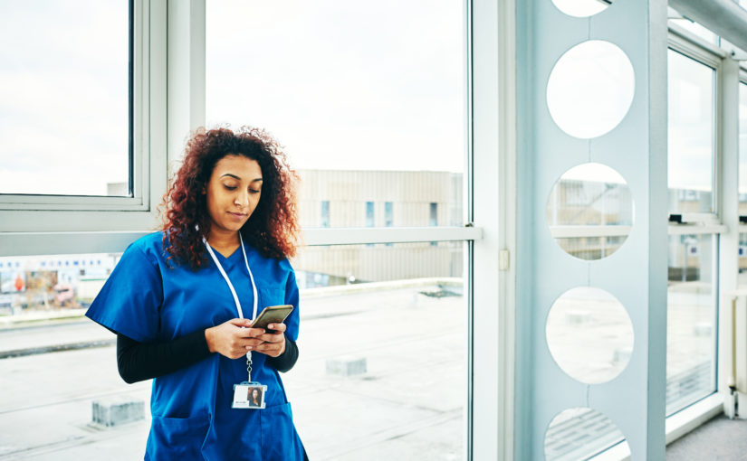
Notes:
We work with unions on small projects that help us learn how to respond to common problems they have
For example, we worked with a nurses’ union on how to make sure their members’ contact data was more accurate.
This was important as it helps them offer more relevant online trainings to their members, so they are happier with their union membership.

Slide 16
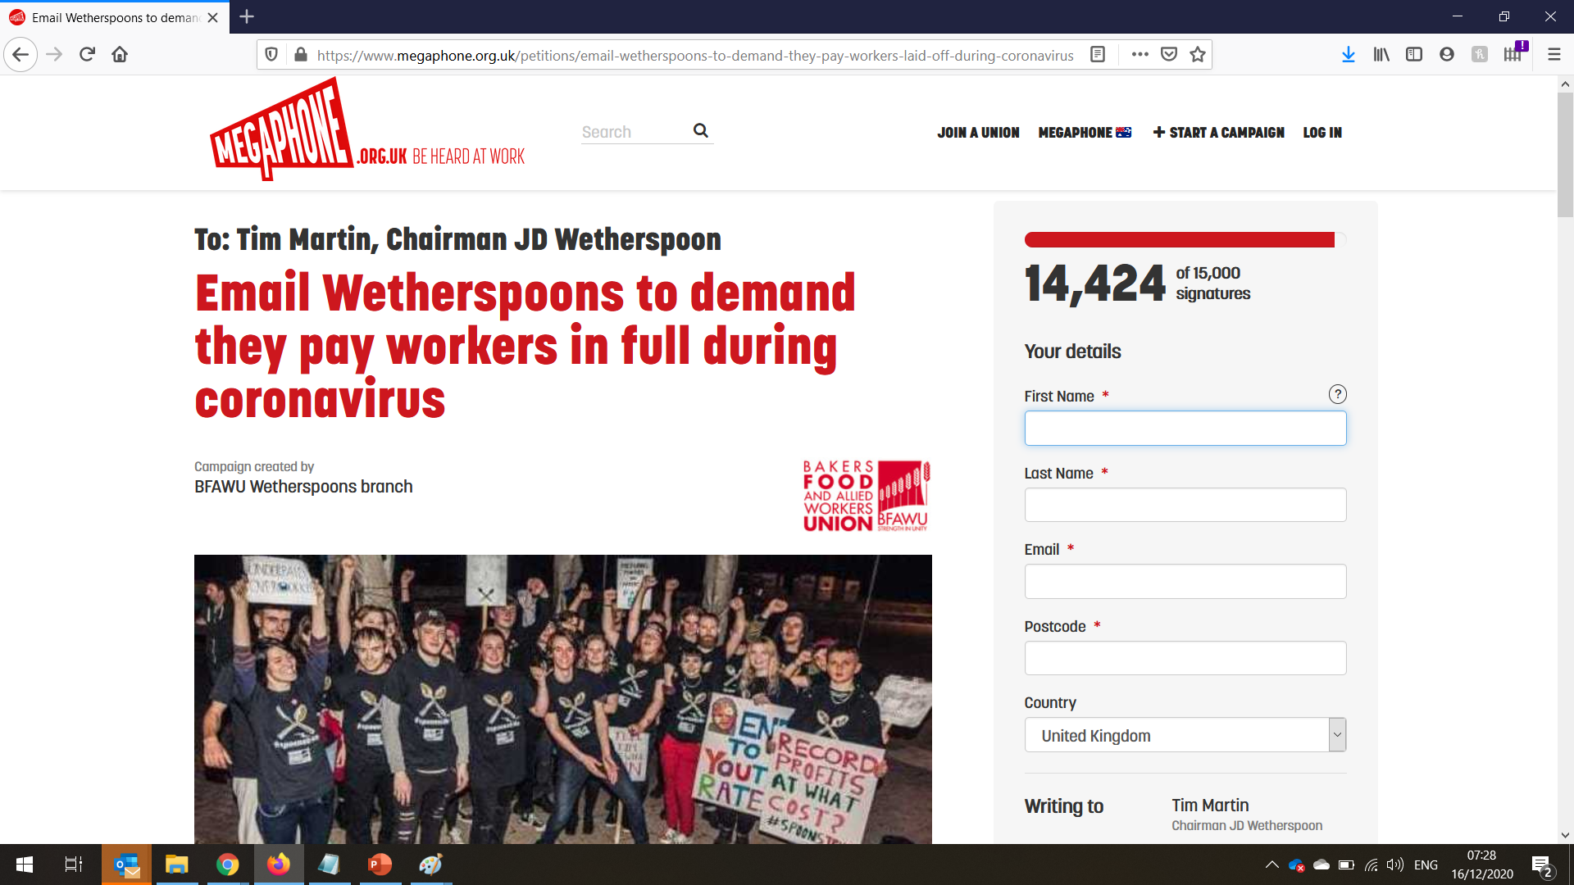
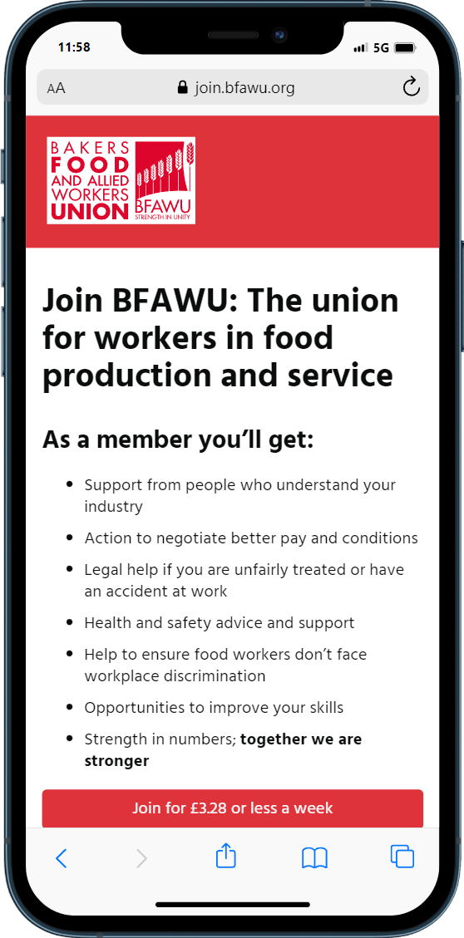
Notes:
We also run some shared tools for unions. Here is an online petition site we run called Megaphone.
It lets our unions run online campaigns for free. And it helps them make contact with new workers in important workplaces or industries, and introduce them to the union.
And on the phone here is another product we have worked on to help improve online joining for unions
so fewer people get lost whilst they’re trying to join up.

Slide 17
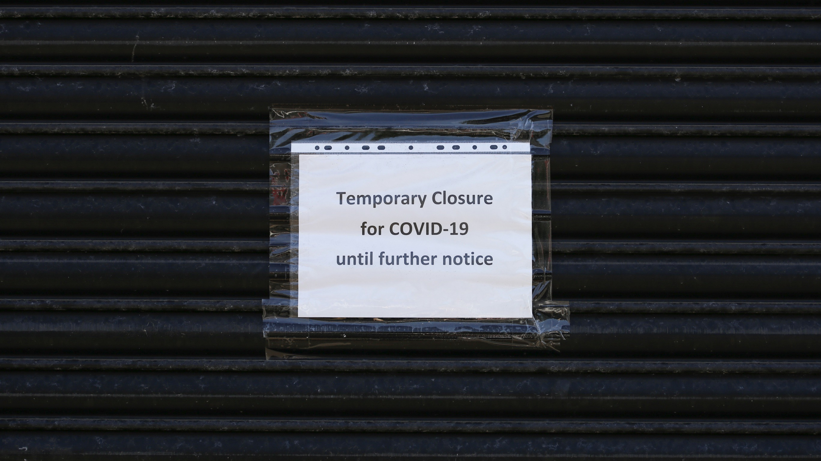
Notes:
Over those four years, we’ve seen an improvement in union digitisation.
I’d like to take credit for that. But it’s true to say that the covid pandemic has been just as important for union digital.
We saw a lot of disruption when the UK went into lockdown for months.
Members suddenly needed urgent support
But because we couldn’t do physical meetings any more, there was no choice but to move as much activity online as possible.
The luckier unions had already moved to cloud-based office systems and telephony.
These were really helpful as they meant we could immediately start working from home.
But those unions that were still reliant on older IT had more problems with this. Lots of them had problems in talking to members - for example where they couldn’t get into the office to answer the telephone.
Those staff who already had experience of flexible working made the switch easier. That’s especially true with union organisers, who were used to working whilst travelling, and using their initiative to solve problems.
As it became obvious this was going to stay for many months, a number of unions brought forward digital change projects
And we also saw much greater willingness for unions to innovate.

Slide 18
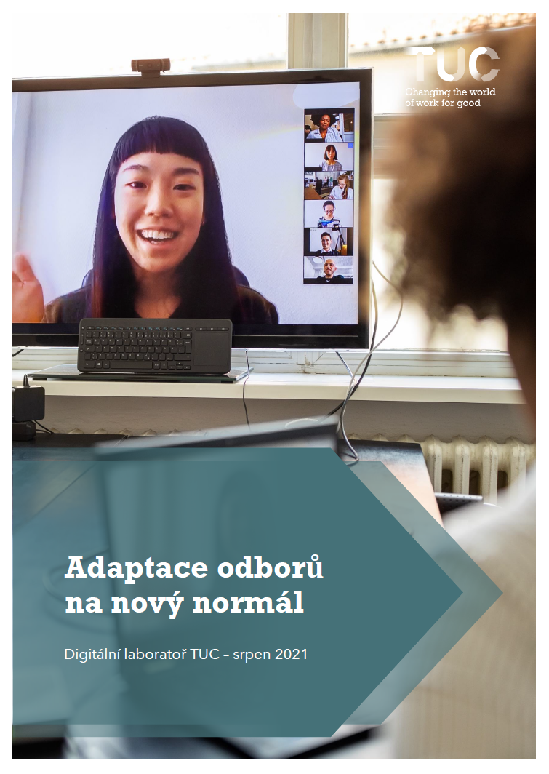
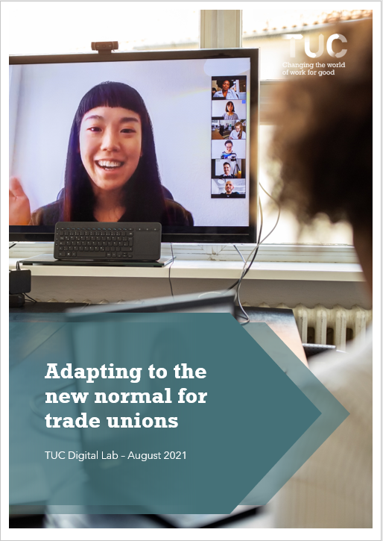
Notes:
We did some research into all of this, which became this report. I was really excited that it’s been translated into Czech.
We knew that lots of the changes from the pandemic were not going to go away once things got better.
People have got used to doing things differently now, and so after the pandemic, we have entered a “new normal”.
In some cases the pandemic created new issues. In other cases it made existing trends develop more quickly than before.
We asked our unions what they thought were the challenges they faced in adjusting to this new normal.
They fell into four main areas.

Slide 19
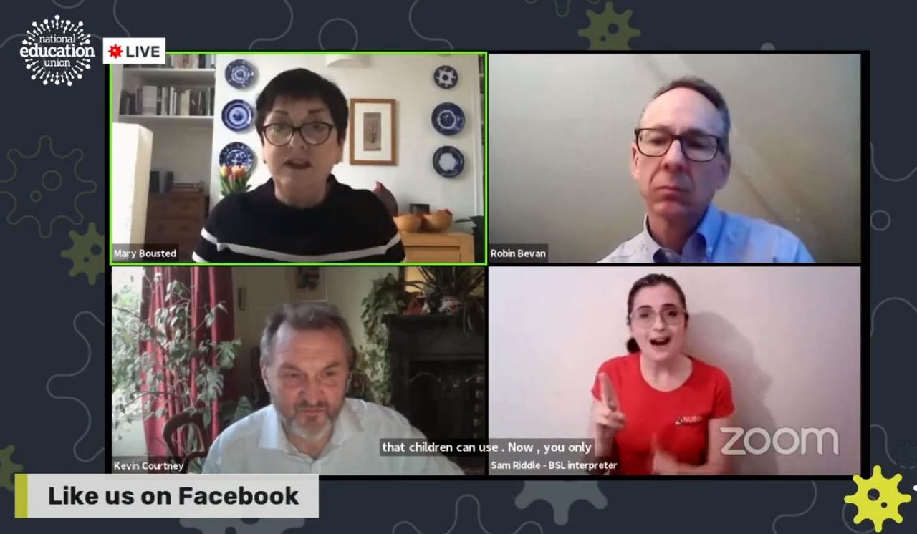
Notes:
Firstly there are challenges of how we keep the high level of engagement with members that happened during the pandemic.
Members wanted much more digital content, much more quickly. And they wanted more ways to get involved. Local meetings went online and many more people started attending them. Union website use rose a lot.
This is one of our teachers’ union’s enormous zoom calls - they got up to 80,000 people live on a call. Their members were worried that the government were not closing schools, and so these regular news updates from the union were hugely popular.
Thousands of members who had never been to a union meeting before joined the calls. They recruited hundreds of new activists.
This was a great opportunity but it gives us a big challenge in keeping levels of engagement that high:
We need to understand what digital content members really want.
We need to work out how the right content can help attract new workers. What will be important enough to them to make them want to join in large numbers?
We need to target our content to the right people, so they see more of what they want, not just more of what they don’t want.
We need to do more to include the groups who have been excluded so far. Disabled members and women members were much more likely to join a new online meeting than an old physical meeting. But still not everyone can access the technology.
We need to find ways to directly collaborate better with members online, as well as just giving them information.
And we need to make our online meetings more effective - not just more of them. There’s a risk of “zoom fatigue” - if we use online calls where they aren’t really needed.

Slide 20

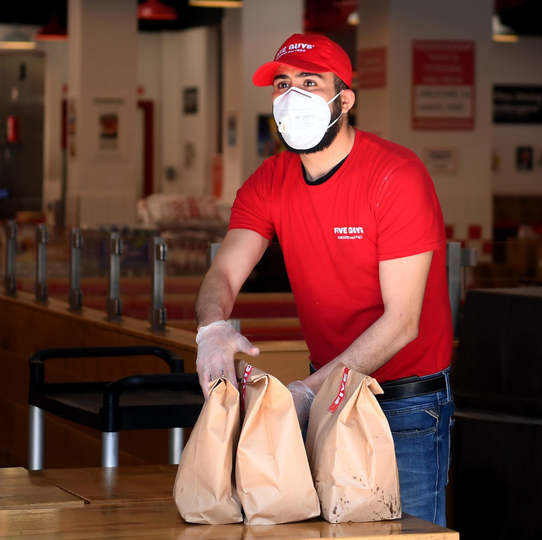
Notes:
The second group of challenges are about the different experiences people are having of work.
Many workers improved their digital skills and equipment so they could work from home, but others kept working just as they were.
And millions of workers spent months unable to work, whilst their employers were closed.
So some people were safe and comfortable, but others’ working lives became harder.
Related to this, we need to find ways to bring the next wave of people online. So they can join those who already became more comfortable with digital.
We need to help our existing union staff reskill into the new digital roles we need for the future.
We need to support members whose industries are changing rapidly because of the new ways of working.
And we need to support members who now work from home in dealing with issues like employer surveillance and a right to disconnect from work.

Slide 21
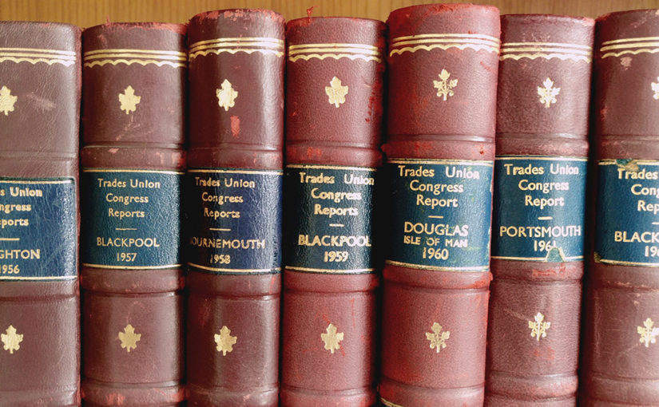
Notes:
Thirdly, we’ve got a big challenge around adapting our old union structures to fit the new reality.
We had a period of fast innovation, because we needed to get things done quickly and the old ways weren’t possible.
Now the old ways are possible once again, we need to find a blend that doesn’t lose the new things that members like, but that still fits with democratic control.
Some challenges we have here are :
We need to find the right balance for democratic processes. What works well in our democracy, and what could work better now?
But we don’t want to waste resources by doing everything twice - online and offline as well.
We need to protect improvements we made in “new power” - where activists were empowered to take bigger roles and more initiative.
Union constitutions are very important in the UK as they are how we are officially regulated. We need to find the opportunities to fit digital ways of working into our constitutions, and make those rules easier to change when we need it.
And we need to find ways to change our culture to keep innovation happening, even when there isn’t the pressure of a crisis to drive it.

Slide 22
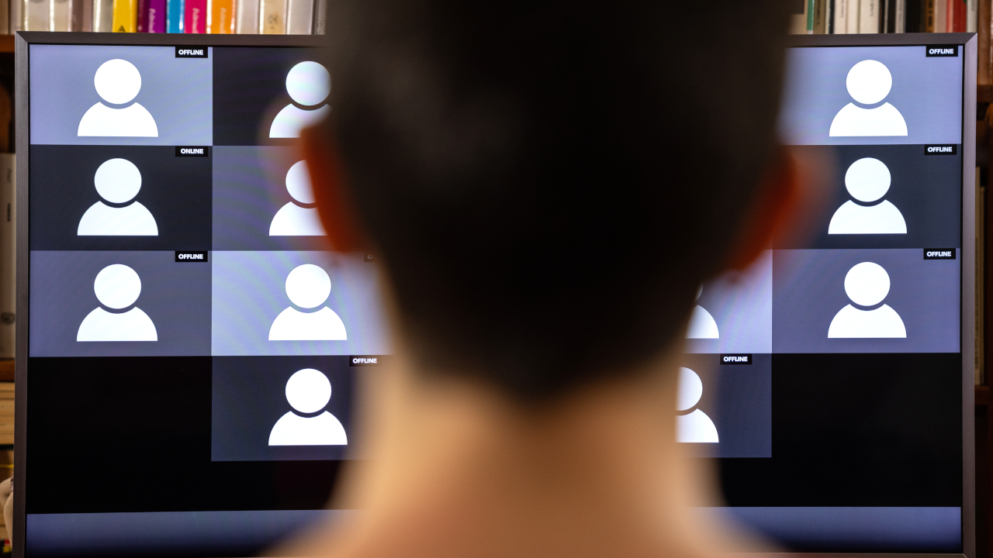
Notes:
And finally we have big problems around building relationships, when we can only contact people online.
Union organising is all about trusted relationships. But if we lose in-person activity and mass attendance in workplaces, we lose the opportunity to build those relationships.
Our challenges here are:
We need to be better at digital campaigning to get more people involved in union actions.
We need to get better at negotiating with employers in an online meeting, where it can be hard to understand both sides.
We need to organise workers who might never meet each other. And find a way to build a sense of community without so many physical meetings.
We need to offer better support to the people who join us online, and who don’t meet activists when they are joining.
We have to find ways to network better between unions and share informal knowledge.
And we have make sure that we have a focus on collective organising in everything new that we do. It is easier to create new digital services just for individuals, but that’s not a union.

Slide 23
digital.tuc.org.uk
Notes:
If you want to find out more, and stay in touch with the Digital Lab as it develops, visit the website at digital.tuc.org.uk, where you can find resources and sign up to email updates.

